Slide 1
Database Relationships

Slide 2
Types of Relationships
One to one
Person to Driver’s License, Country to President, Person to Social Security Number (in theory)
One to many
Mother to Child, Division to Department, Supervisor to Employees, Owner to Car, Customer to Invoice
Many to many
Parent to child, student to professor, nurse to patient, Invoice to Inventory Part, student to class

Slide 3
In Theory and Practice
In theory, a DBMS could represent any of the relationships shown
In practice, many-to-many relationships are never done directly
Instead it is broken down into two one-to-many relationships (easier to implement in DBMS, easier to understand)

Slide 4
Students and Classes
Many to many
one student has many (>= 0) classes
one class has many (>= 0) students
Students
Classes

Slide 5
Changing Many-Many to 1-Many
Students to Classes is many-to-many
To change it to two one-to-many relationships, One table is just Students, one table is just Classes, then a third table gives the relationship “enrolled” and ties the two other tables together. The relationships between the two original tables and the Enrolled table are one-to-many.

Slide 6
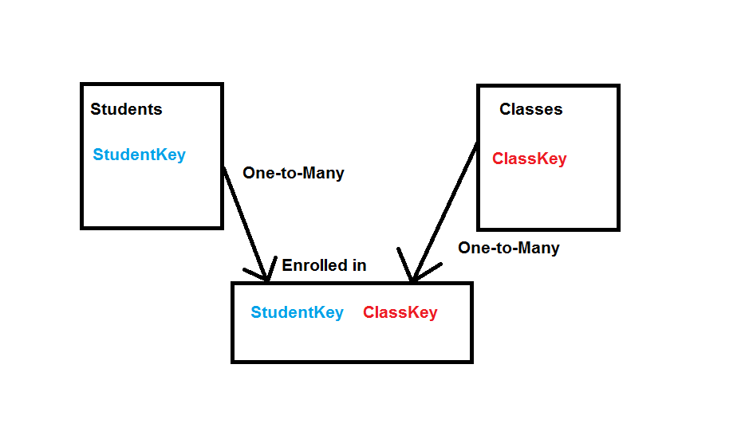
Two One-to-Many Relationships

Slide 7
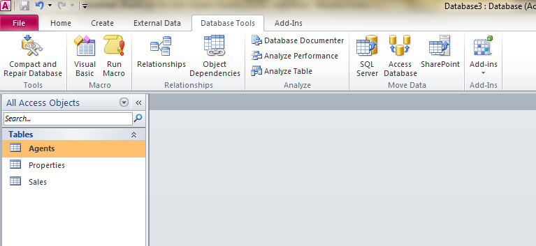
To make a relationship between tables
Start by clicking on the Database Tools menu on the Ribbon

Slide 8
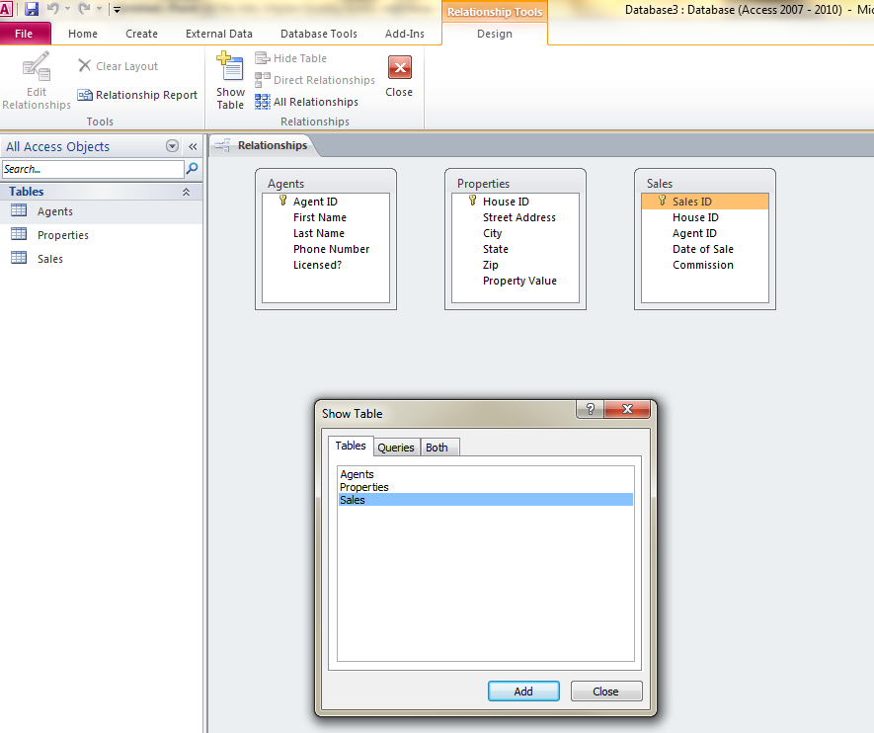
Add the tables that you want

Slide 9
Adding relationships
Decide which fields in which tables you want to relate
Drag the arrows from one of the fields you want to relate to the other – not just the TABLES but the specific fields

Slide 10
Referential Integrity
“References have integrity” (what does this mean?)
When you state the relationships that must hold between the tables in a database, the DBMS enforces those relationships
If a table is on the “many” end of a one-to-many relationship, when you enter a record in the table, the DBMS checks to see that there does exist ONE record in the other table to match

Slide 11
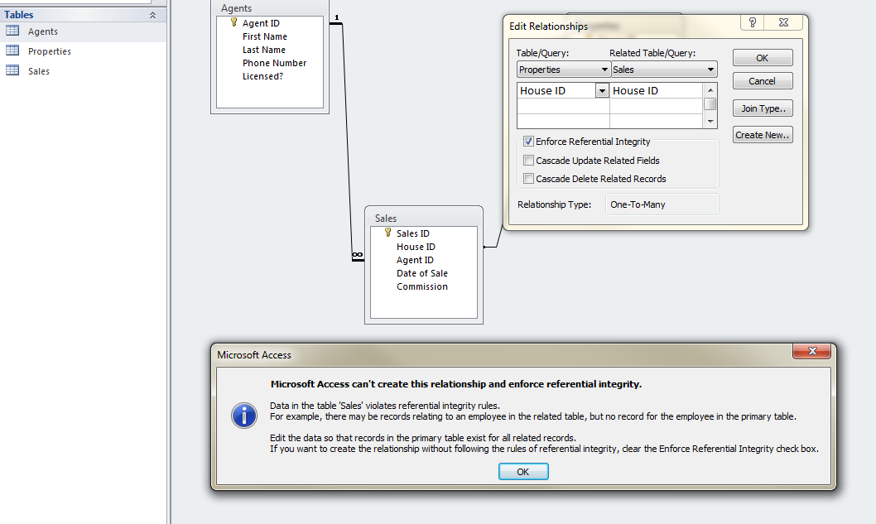
Referential Integrity violation

